Slide 1

Spring of Code
Artificial Intelligence
(Machine Learning & Deep Learning)
Instructor
Asad Ullah
- Research Assistant (DIP Lab)
Duration
03 Months
(Feb – April)

Slide 2
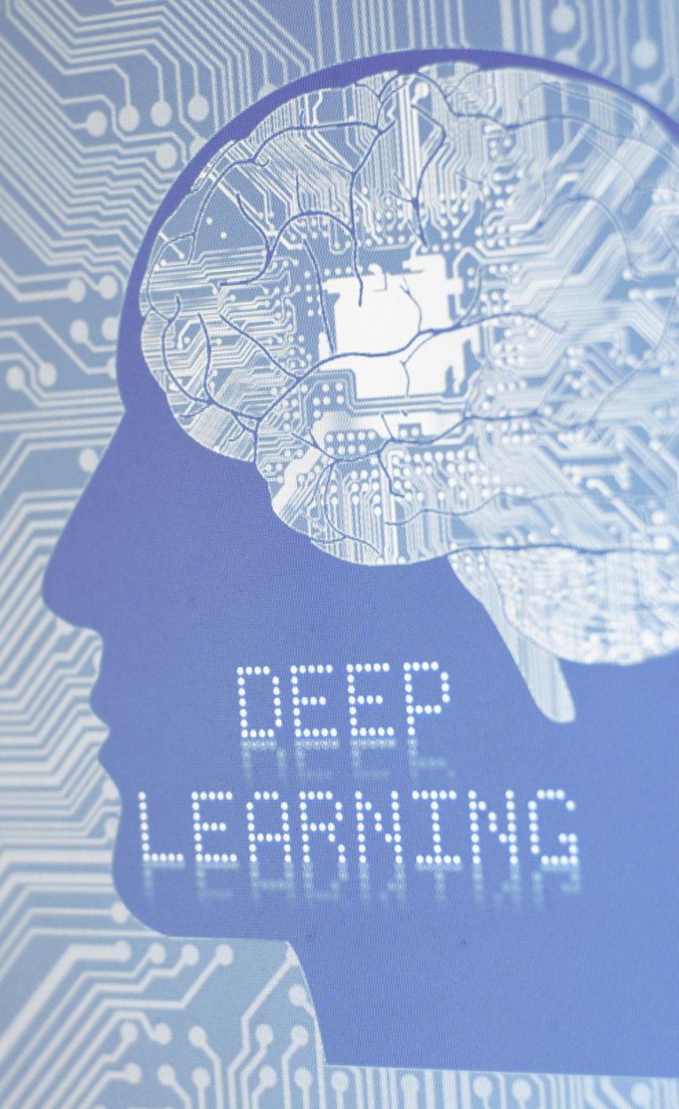
Day 01 – Deep Learning
(Artificial Neural Networks)
Objectives:
Introduction to Deep Learning
Artificial Neural Networks
Activation Functions

Slide 3
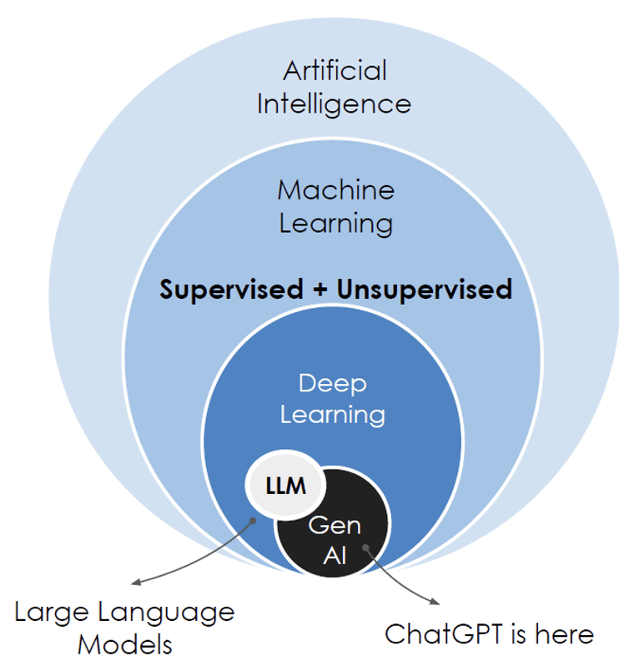
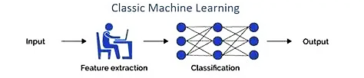
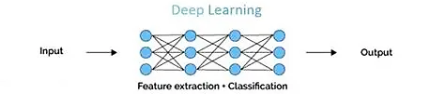
Deep Learning
Deep Learning is a subset of machine learning that uses neural networks to learn representations of data.
The fundamental unit of such networks is a small bundle of computation called an artificial neuron.
Machine Learning:
Deep Learning:
Notes:
- Scientific computing involves using computational methods to solve complex scientific and mathematical problems.
Numeric (1995):
First version was called "Numeric" or "Numerical Python"
Created by Jim Hugunin at MIT
Evolution to NumPy (2006):
Travis Oliphant led the creation of NumPy

Slide 4
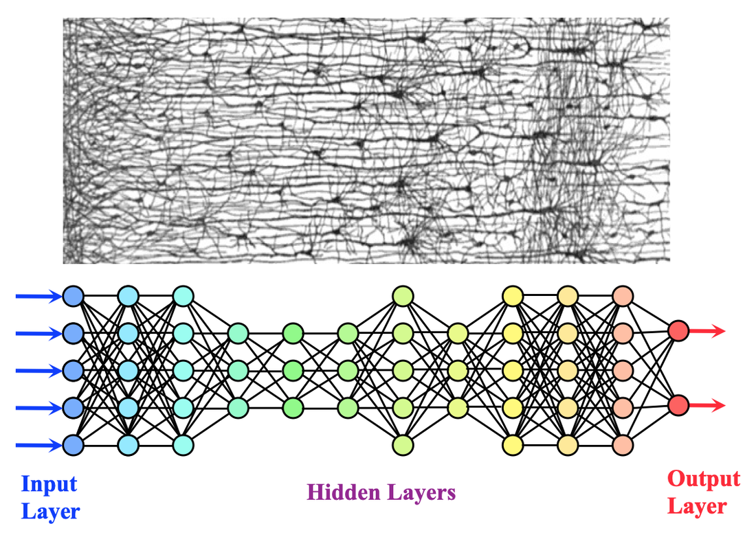
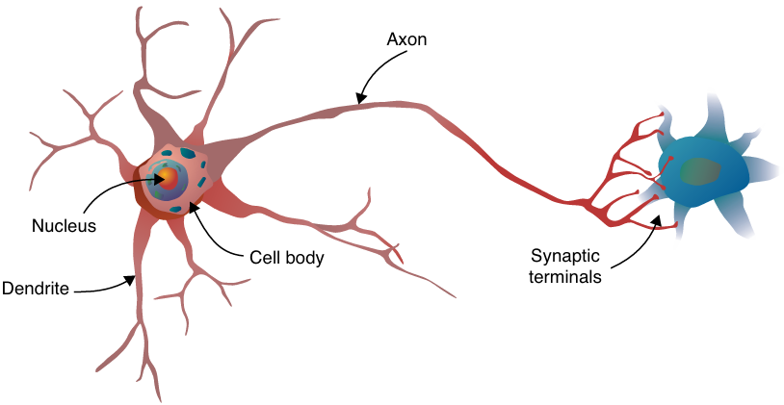
Neural Networks
A Neural Network is a computational model inspired by the way biological neurons in the human brain process information.
Composed of interconnected nodes (neurons) organized in layers.
It learns to map inputs to outputs by adjusting connection strengths (weights)
Notes:
- Scientific computing involves using computational methods to solve complex scientific and mathematical problems.
Numeric (1995):
First version was called "Numeric" or "Numerical Python"
Created by Jim Hugunin at MIT
Evolution to NumPy (2006):
Travis Oliphant led the creation of NumPy

Slide 5
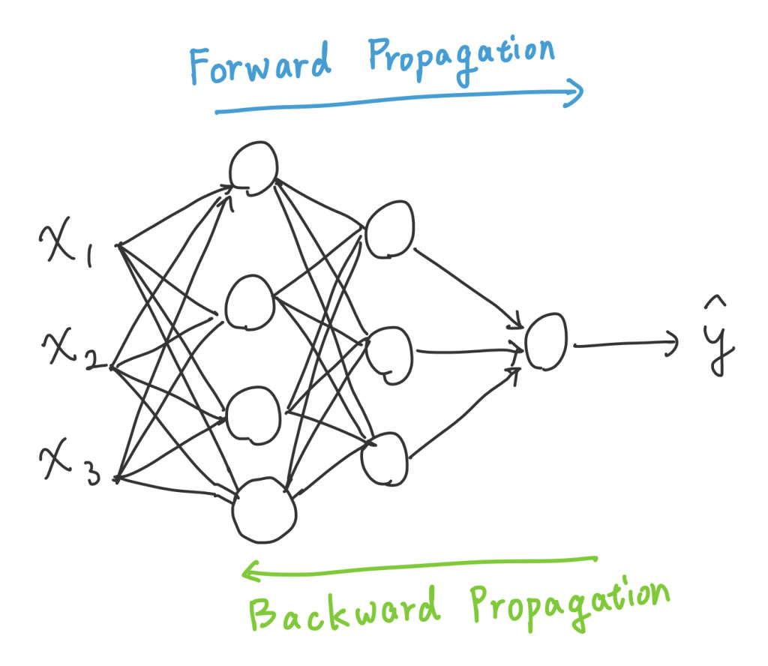
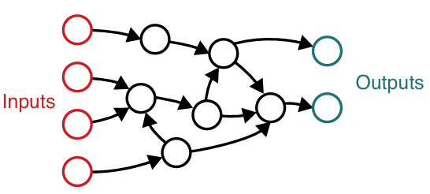
Neural Networks Computation Graphs
Neural networks can be represented as directed acyclic graphs (DAGs) where:
  Nodes (Vertices) = Neurons/Units
  Edges = Weighted connections between neurons
  Direction = Flow of information (input to output)
  Acyclic = No loops - information flows forward only
Feed Forward Neural Network
Notes:
- Scientific computing involves using computational methods to solve complex scientific and mathematical problems.
Numeric (1995):
First version was called "Numeric" or "Numerical Python"
Created by Jim Hugunin at MIT
Evolution to NumPy (2006):
Travis Oliphant led the creation of NumPy

Slide 6
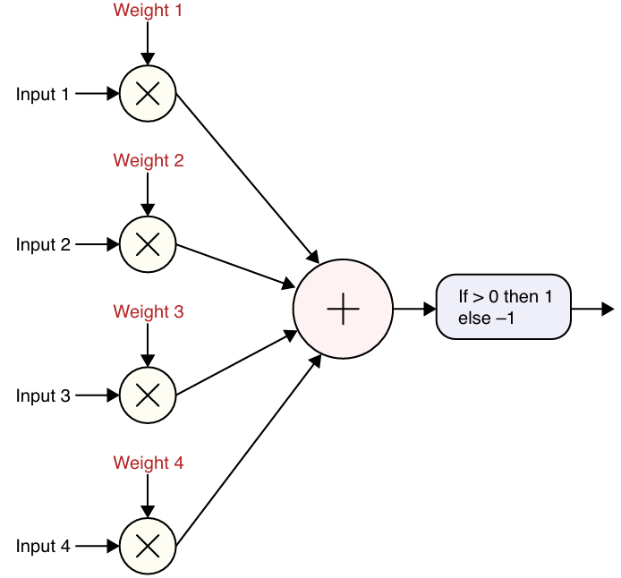
The Perceptron (Original)
Notes:
- Scientific computing involves using computational methods to solve complex scientific and mathematical problems.
Numeric (1995):
First version was called "Numeric" or "Numerical Python"
Created by Jim Hugunin at MIT
Evolution to NumPy (2006):
Travis Oliphant led the creation of NumPy

Slide 7
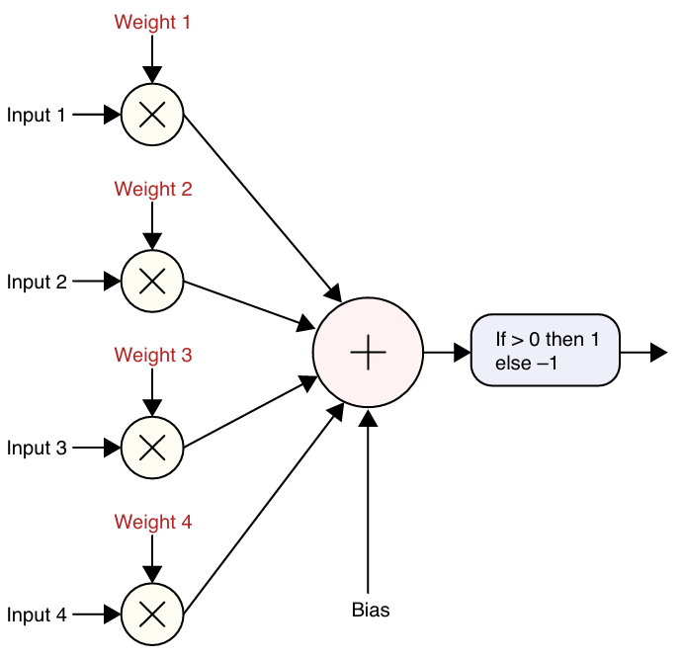
Artificial Neuron (Modern)
Notes:
- Scientific computing involves using computational methods to solve complex scientific and mathematical problems.
Numeric (1995):
First version was called "Numeric" or "Numerical Python"
Created by Jim Hugunin at MIT
Evolution to NumPy (2006):
Travis Oliphant led the creation of NumPy

Slide 8
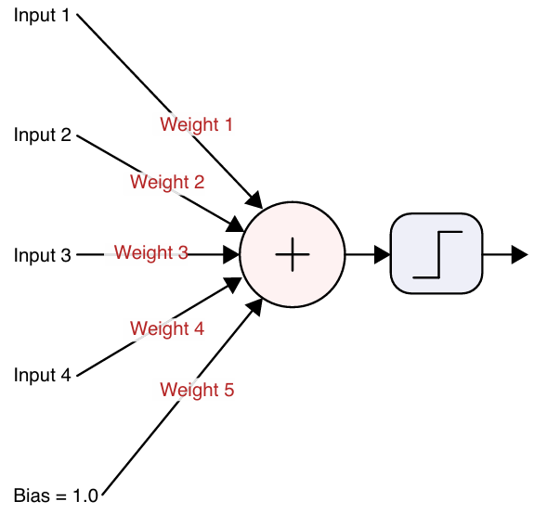
Drawing Artificial Neuron
Notes:
- Scientific computing involves using computational methods to solve complex scientific and mathematical problems.
Numeric (1995):
First version was called "Numeric" or "Numerical Python"
Created by Jim Hugunin at MIT
Evolution to NumPy (2006):
Travis Oliphant led the creation of NumPy

Slide 9
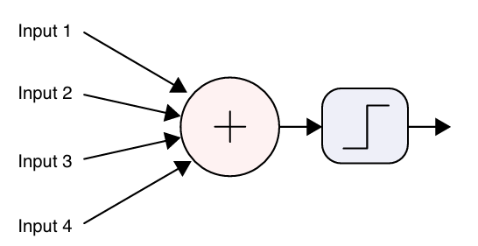
Drawing Artificial Neuron
Compact Form
Notes:
- Scientific computing involves using computational methods to solve complex scientific and mathematical problems.
Numeric (1995):
First version was called "Numeric" or "Numerical Python"
Created by Jim Hugunin at MIT
Evolution to NumPy (2006):
Travis Oliphant led the creation of NumPy

Slide 10
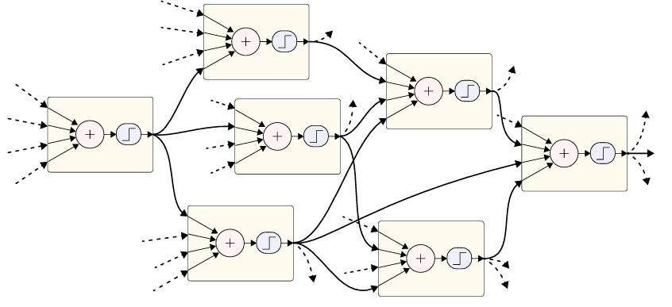
Neural Network
Notes:
- Scientific computing involves using computational methods to solve complex scientific and mathematical problems.
Numeric (1995):
First version was called "Numeric" or "Numerical Python"
Created by Jim Hugunin at MIT
Evolution to NumPy (2006):
Travis Oliphant led the creation of NumPy

Slide 11
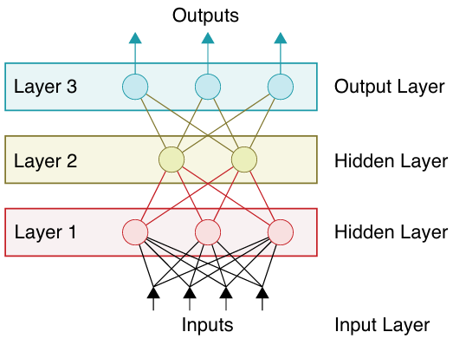
Deep Networks
Notes:
- Scientific computing involves using computational methods to solve complex scientific and mathematical problems.
Numeric (1995):
First version was called "Numeric" or "Numerical Python"
Created by Jim Hugunin at MIT
Evolution to NumPy (2006):
Travis Oliphant led the creation of NumPy

Slide 12
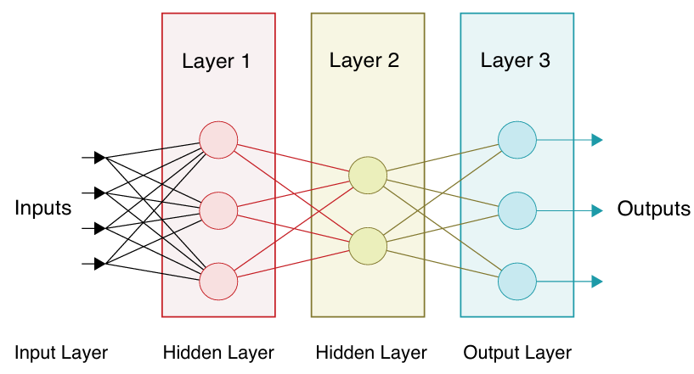
Deep Networks
Notes:
- Scientific computing involves using computational methods to solve complex scientific and mathematical problems.
Numeric (1995):
First version was called "Numeric" or "Numerical Python"
Created by Jim Hugunin at MIT
Evolution to NumPy (2006):
Travis Oliphant led the creation of NumPy

Slide 13



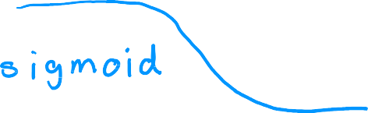




Demand Prediction
input output
𝑥 = 𝑝𝑟𝑖𝑐𝑒
1
𝑎 = 𝑓 𝑥 =
_{1 + 𝑒}− 𝑤𝑥+𝑏
top seller? yes/no
𝑥
𝑎
price

Slide 14
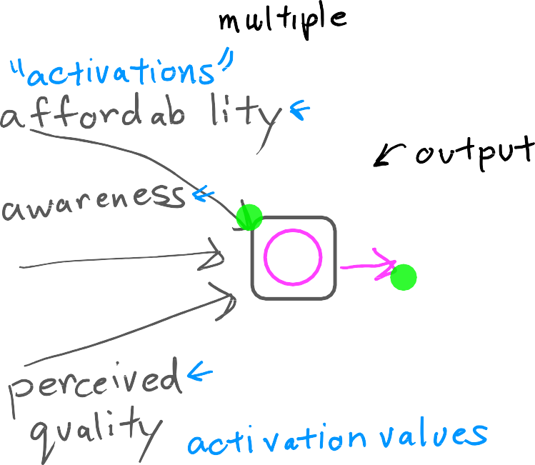




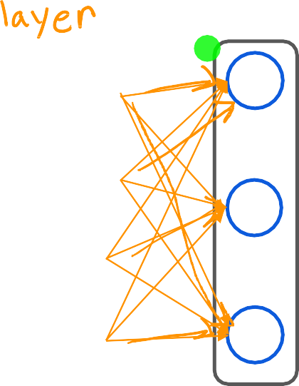





Demand Prediction
layer
price
layer
shipping cost
probability of being a top seller
marketing
material

Slide 15


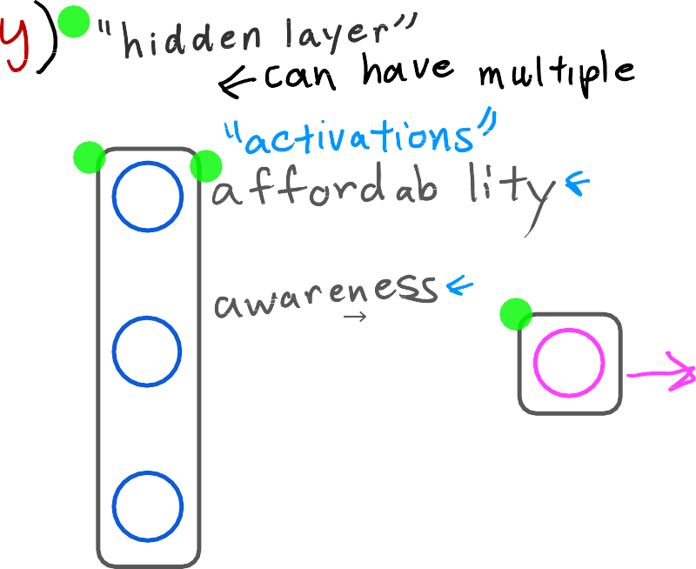



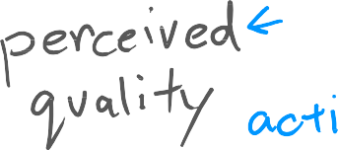


Demand Prediction
layer
price
layer
shipping cost
a
a
probability of being a top seller
marketing
material

Slide 16
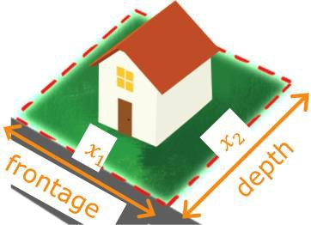


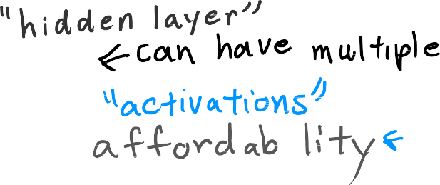






Demand Prediction
layer
price
shipping cost marketing material
layer
a
a
probability of being a top seller

Slide 17








Multiple hidden layers
x
input
a
a
x
output layer
hidden layer
hidden layer
hidden layer
hidden layer
hidden layer
neural network architecture

Slide 18





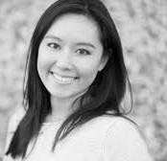





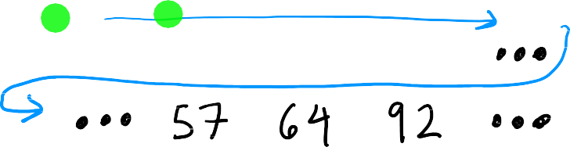










Face recognition
x =

Slide 19
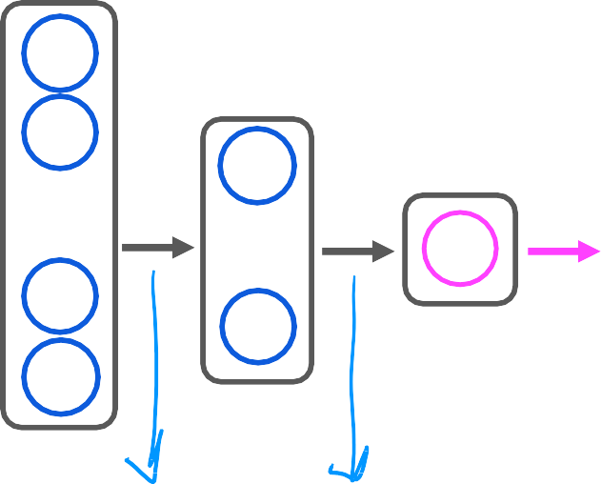








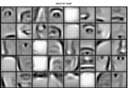


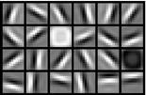
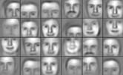




Face recognition
output layer
⋮
⋮
⋮
probability of being
person ‘XYZ’
x
input
source: Convolutional Deep Belief Networks for Scalable Unsupervised Learning of Hierarchical Representations by Honglak Lee, Roger Grosse, Ranganath Andrew Y. Ng

Slide 20


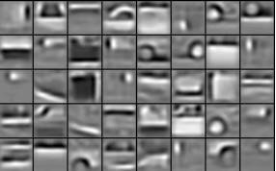
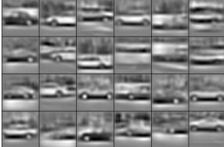




Car classification
output layer
⋮
⋮
⋮
probability of car detected
source: Convolutional Deep Belief Networks for Scalable Unsupervised Learning of Hierarchical Representations by Honglak Lee, Roger Grosse, Ranganath Andrew Y. Ng

Slide 21








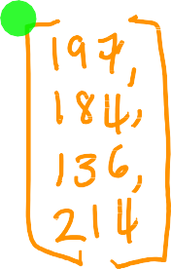







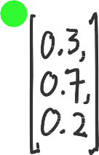







Neural network layer
1
𝑔(𝑧) =
1 + 𝑒^{− 𝑧}
a
]
x
𝑤 , 𝑏₁
𝑎
= 𝑔(w
x + 𝑏 )
vector of activation values from layer 1
layer 0
layer 2
x
w₂ , 𝑏₂
𝑎₂ = 𝑔(w₂ ∙ x + 𝑏₂ )
a
layer 1
w₃ , 𝑏₃
𝑎₃ = 𝑔(w₃ ∙ x + 𝑏₃ )
notation for layer numbering

Slide 22







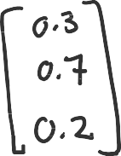


Neural network layer
1
𝑔(𝑧) =
1 + 𝑒^{− 𝑧}
_{a}[1]
_{𝑎}[2]
x
layer 2
𝑤₁ , 𝑏₁
𝑎₁ = 𝑔(w₁ ∙ a^{[1]} + 𝑏₁ )
a scalar value
_{a}[1]
a
layer 1

Slide 23
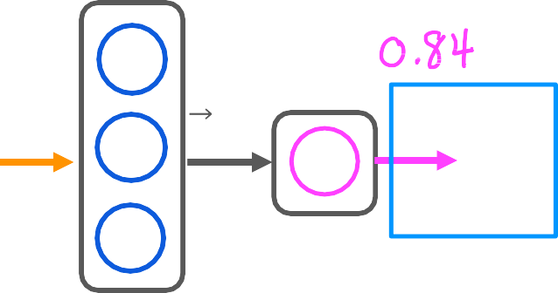






Neural network layer
predict category 1 or 0 (yes/no)
_{𝑎}[2]
_{a}[1]
x
𝑖𝑠 𝑎 ² ≥ 0.5?
𝑦ො = 1 𝑦ො = 0
layer 2
layer 1

Slide 24
More complex neural network
_{a}[1]
_{a}[2]
_{a}[3]
_{a}[4]
x
input
layer 0
layer 1
layer 2
layer 3
layer 4
hidden layers
output
layer

Slide 25











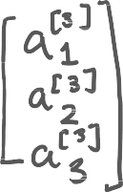

More complex neural network
_{, 𝑏}[3
)
𝑤
𝑎₁ = 𝑔(w₁ ∙ a^{[2]} + 𝑏₁
𝑎₂ = 𝑔(w₂ ∙ a^{[2]} + 𝑏₂ )
1 1
_{a}[1]
_{a}[2]
_{a}[3]
_{a}[2]
_{, 𝑏}[3
x
input
a
[4]
w
a
[3]
2 2
_{w}[ _{, 𝑏}[3
𝑎 = 𝑔(w₃ ∙ a^{[2]} + 𝑏₃ )
3 3
3
layer 1
layer 2
layer 3
layer 4

Slide 26

Notation
_{𝑤}[3]_{, 𝑏}[3]
𝑎^{[3]}= 𝑔(w^{[3]} ∙ a^{[2]} + 𝑏^{[3]})
1 1 1
𝑎[ ]= 𝑔(w[ ] ∙ a[ ] + 𝑏[ ])
1 1
x
input
_{a}[1]
_{a}[2]
_{a}[3]
_{w}[3]_{, 𝑏}[3]
a
[4]
a
[2]
a
[3]
2 2
_{w}[3]_{, 𝑏}[3]
𝑎^{[3]}= 𝑔(w^{[3]} ∙ a^{[2]} + 𝑏^{[3]})
3 3 3
3 3
layer 1
layer 2
layer 3
layer 4
Question:
Can you fill in the superscripts and
subscripts for the second neuron?

Slide 27


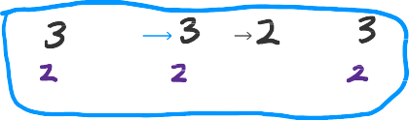


Notation
x
x
input
_{𝑤}[3]_{, 𝑏}[3]
𝑎^{[3]}= 𝑔(w^{[3]} ∙ a^{[2]} + 𝑏^{[3]})
1 1 1
𝑎[ ]= 𝑔(w[ ] ∙ a[ ] + 𝑏[ ])
1 1
_{a}[1]
_{a}[2]
_{a}[3]
_{w}[3]_{, 𝑏}[3]
a
[4]
a
[2]
a
[3]
2 2
_{w}[3]_{, 𝑏}[3]
𝑎^{[3]}= 𝑔(w^{[3]} ∙ a^{[2]} + 𝑏^{[3]})
3 3 3
3 3
layer 3
layer 4
layer 1 layer 2
Activation value of layer 𝑙, unit(neuron) 𝑗
_{𝑎}[3]
[3] [3]
[2]
₂ = 𝑔(w₂ ∙ a + 𝑏₂ )
output of layer 𝑙 − 1
(previous layer)
𝑎^{[𝑙]} = 𝑔(w^{[𝑙]} ∙ a^{[𝑙−1]} + 𝑏^{[𝑙]})
𝑗 𝑗 𝑗
sigmoid
Parameters w & b of layer 𝑙, unit 𝑗

Slide 28
AI
ANI
(artificial narrow intelligence)
E.g., smart speaker, self-driving car, web search, AI in farming and factories
AGI
(artificial general intelligence)
Do anything a human can do

Slide 29

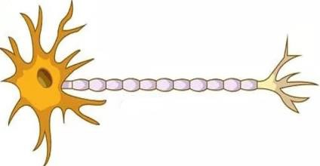







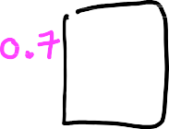







Biological neuron
Simplified mathematical model of a neuron
inputs outputs
inputs
outputs
image source: https://biologydictionary.net/sensory-neuron/

Slide 30
Neural network and the brain
Can we mimic the human brain?
vs
x
𝑓(x)
We have (almost) no idea how the brain works

Slide 31
Thank You

